Slide 1
Thursday 10th March 2022
Mental Health and Wellbeing Coffee Morning
Subtitle

Slide 2
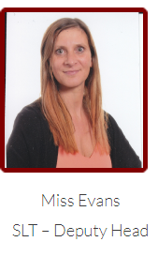
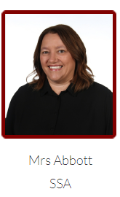
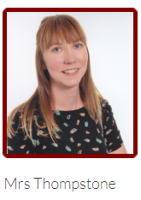
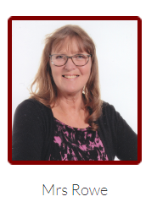
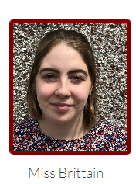
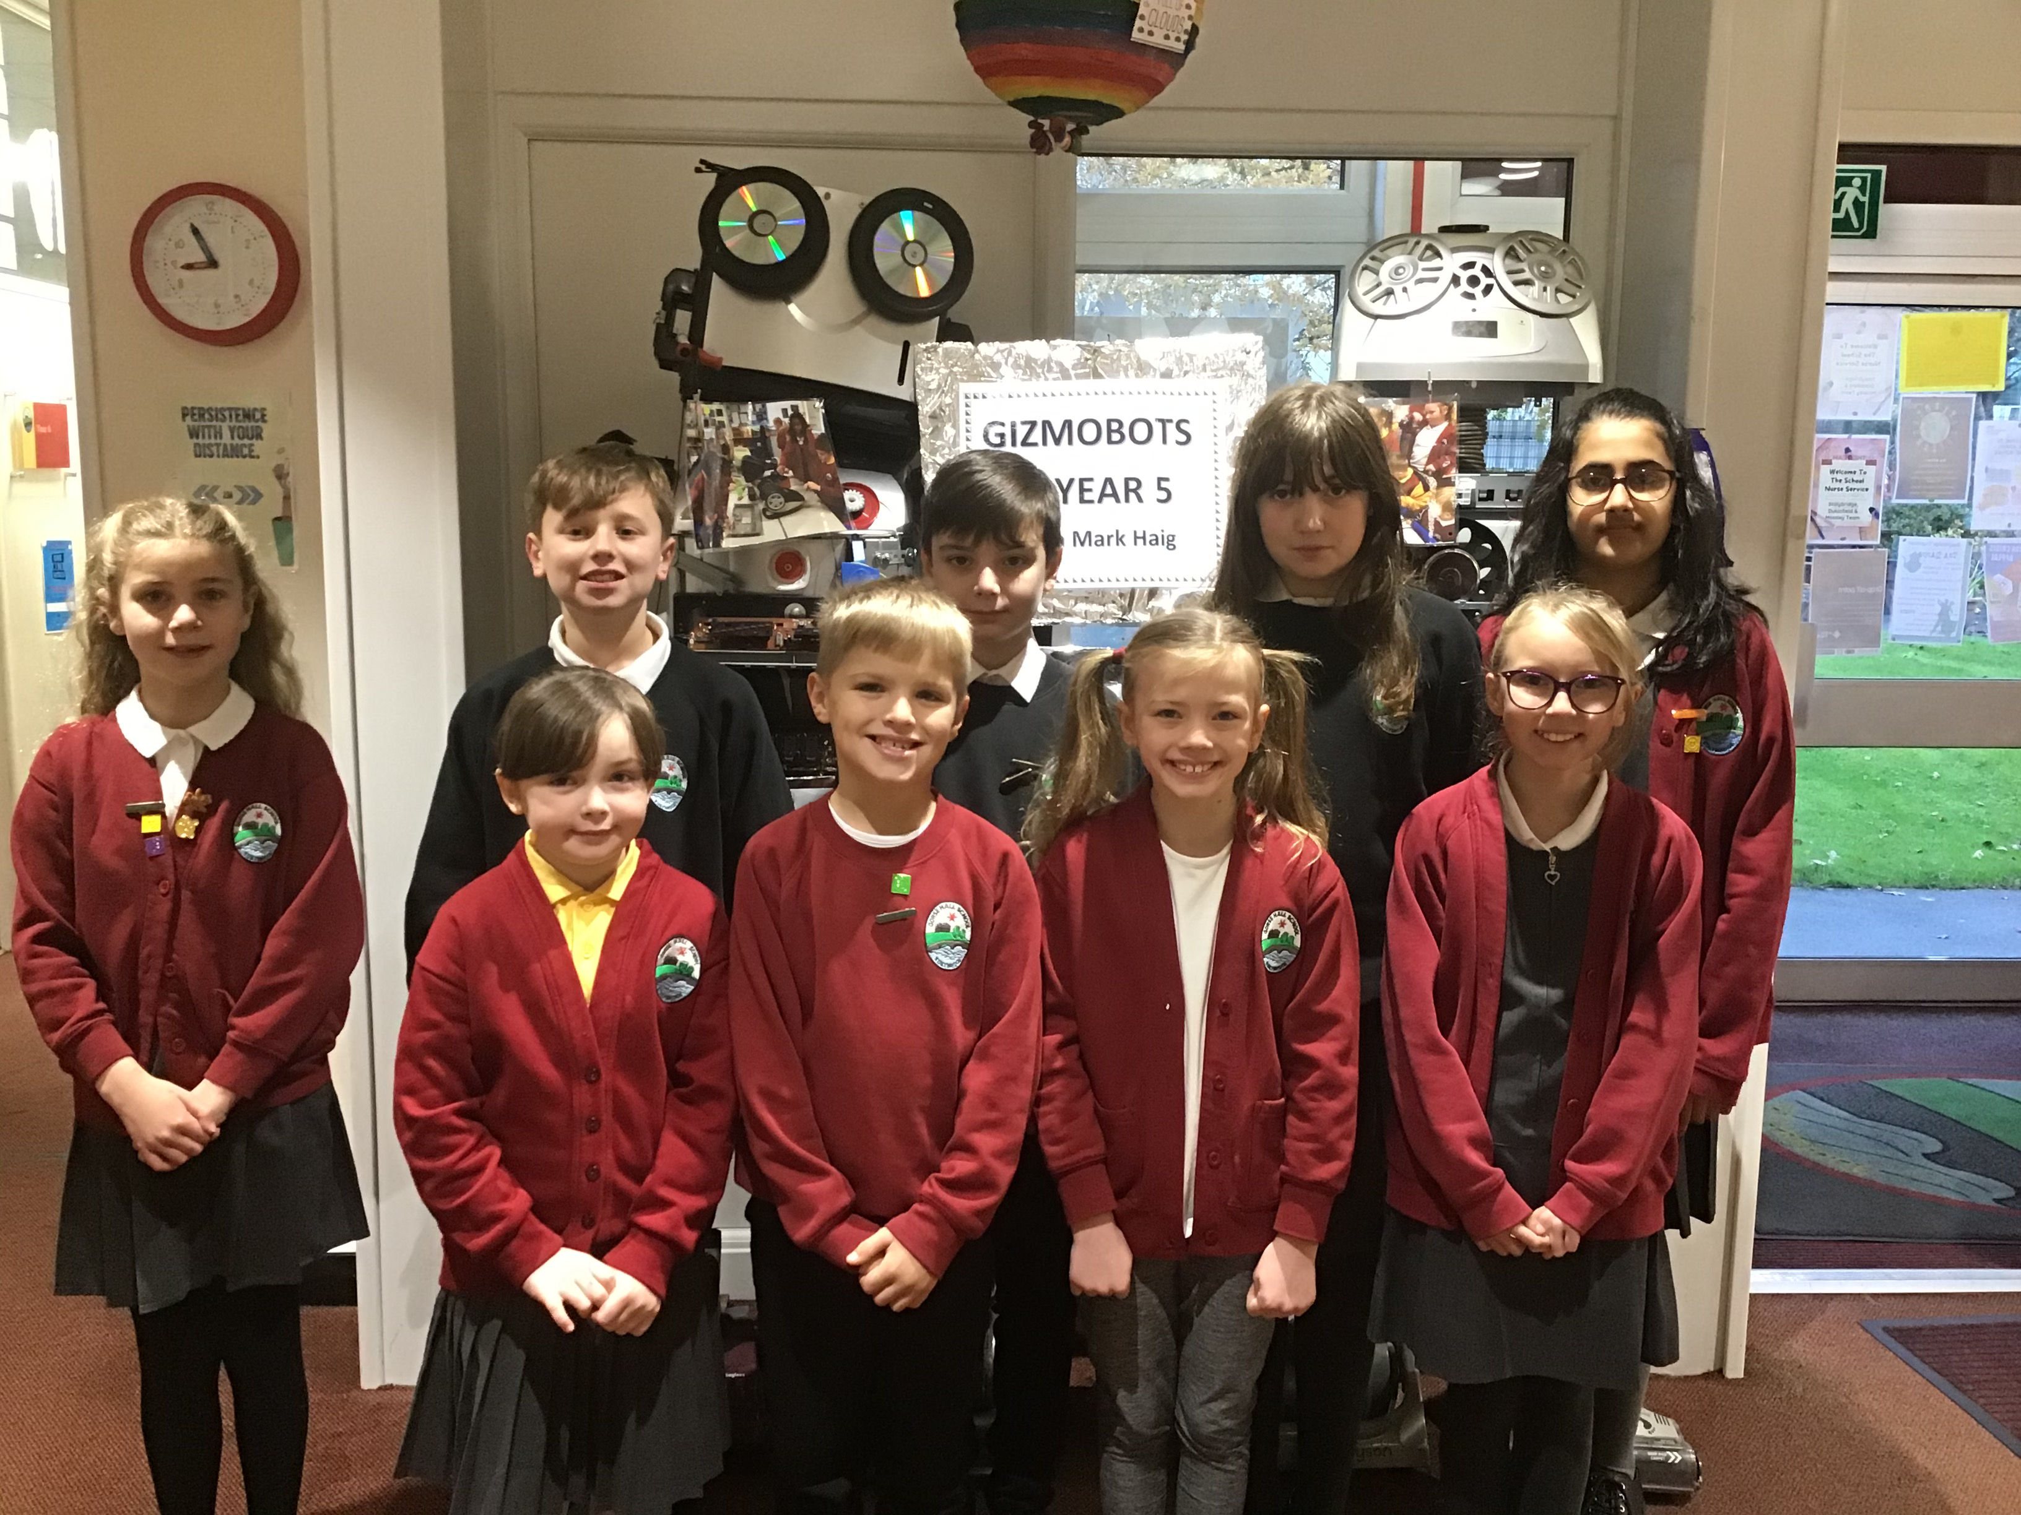
Mental Health and Wellbeing Lead Team
Mr Goodchild –Mental Health and Wellbeing Link Governor
Miss Hand
Wellbeing Ambassadors

Slide 3
AcSEED Award 2020-2021

Slide 4
Mental Health Lead
Anna Freud Link programme – 1 year (termly meetings) Mental Health Champion training mental Health Lead training March/April Connect 5 training Connect 5 Train the trainer Parenting Courses – Solihull parenting Parental Conflict
In house training staff
Wellbeing Team/SEN team
Bereavement and Loss Starving the Anxiety Gremlin Lego Therapy training
Headteacher
Mental Health First Aider

Slide 5
Shared vision
Notes:
NOTE: To change images on this slide, select a picture and delete it. Then click the Insert Picture icon in the placeholder to insert your own image.

Slide 6
Putting on your gas mask first…

Slide 7
Putting on your gas mask first…
Right Care, Right Place:
https://www.tamesideandglossopccg.org/local-services/right-care-right-place
https://gorsehall.tameside.sch.uk/
https://www.tameside.gov.uk/coronavirus/mentalhealth

Slide 8
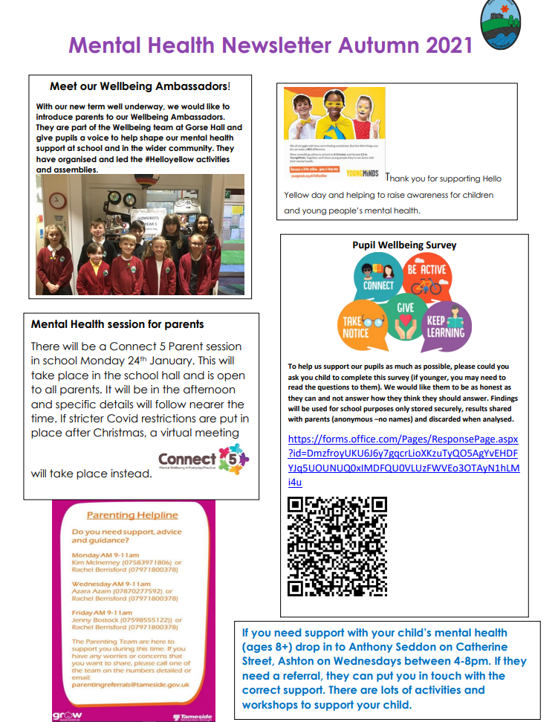
Support in the community for you as a parent
https://gorsehall.tameside.sch.uk/

Slide 9
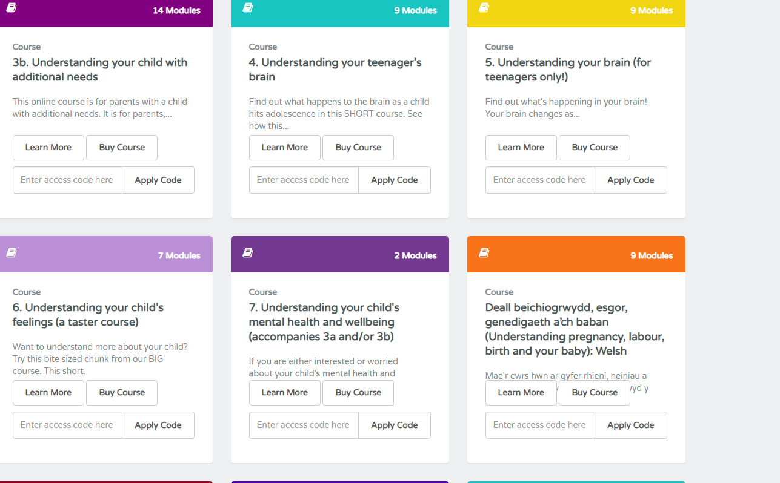
https://www.gotogrowtameside.co.uk/

Slide 10
Healthy Young Minds referral - GP, school or other professional
Parents

Slide 13
Connect 5 Training Wellbeing Team –Spring 2 Provide sessions for parents – Summer E safety survey –Self Harm Content

Slide 14
Jigsaw – PSHE/RSE
Self-regulation
Lunchtime Nuture sessions
Lego Therapy
Starving The Anxiety Gremlin
HelloYellow
Mental Health Awareness week

Slide 15
Any Questions?

